Slide 1
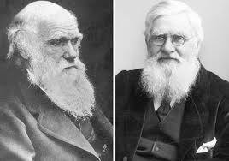
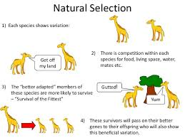
Daily review
CFU 1
What is Natural Selection?
Natural Selection
Natural selection is the process by which individuals that are best suited to their environment pass on their genes.
This theory was proposed by Charles Darwin and Alfred Wallace in the 1850’s.
It explains the mechanics behind
how organisms adapt and change
over time.

Slide 2
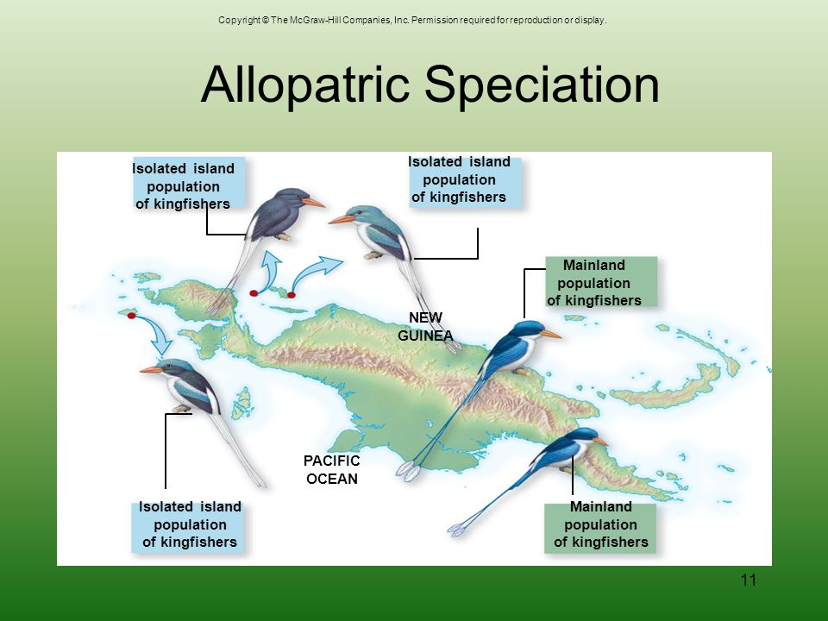
Daily review
CFU 1
Define speciation
CFU 2
What are the three steps involved in speciation?
CFU 3
Think/pair/share: How are the kingfishers in the image below isolated from each other?
Speciation
Natural selection leads to the development of new species.
Speciation is the process by which one species splits into two or more separate species.
The process of speciation occurs in three steps:
Variation
Isolation
Selection.

Slide 3
Evolution

Slide 4
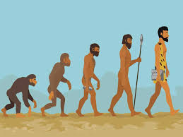
Learning Objectives
CFU
What are we going to learn?
Describe the Theory of Evolution
Identify and describe forms of evidence for evolution
Activate Prior Knowledge
What is the image to the right suggesting?
Why might this representation of human evolution be inaccurate?

Slide 5
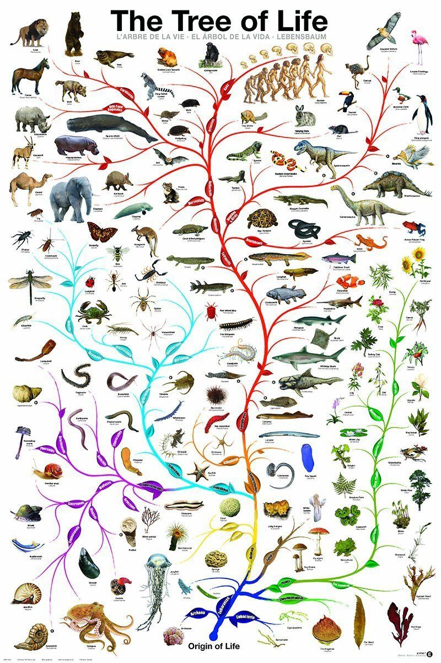
Concept Development
CFU 1
Define the Theory of Evolution
Theory of Evolution
Prior to the theory of evolution, it was accepted that life was ‘created’
Based on a collection of evidence, scientists developed the Theory of Evolution
The Theory of Evolution is: Gradual change in the genetic material of a population of organisms over a period of time

Slide 6
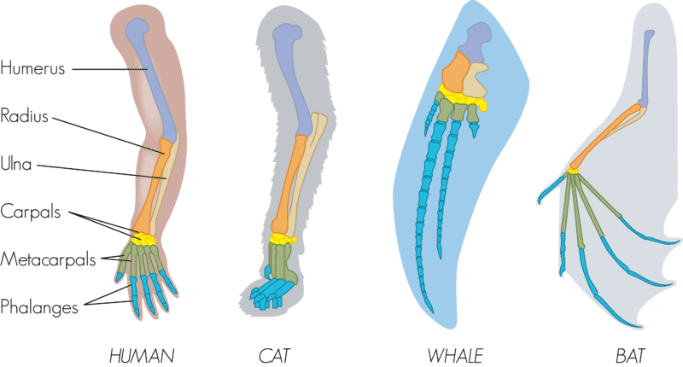
Concept Development
CFU 1
What causes divergent evolution to occur?
Types of Evolution
Divergent Evolution
Two organisms share a common ancestor
Organisms are exposed to different selection pressures
Over time they have evolved into different species (speciation)
However they retain some
characteristics of their common
ancestors
Homologous structures
E.g. forelimb structure of
various animals have the same
bone arrangement
CFU 2
Describe how the image below supports the idea of divergent evolution

Slide 7
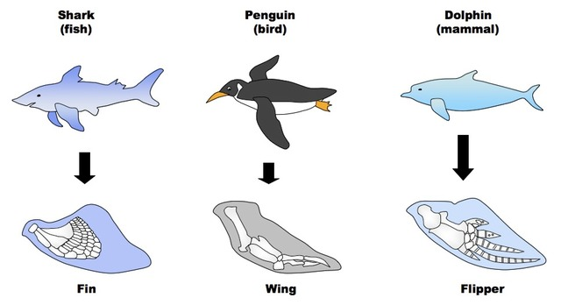
Concept Development
CFU 1
True or false: convergent evolution involves similar selection pressures
Types of Evolution
Convergent Evolution
Two organisms DO NOT share a common ancestor
Organisms are exposed to similar selection pressures
Different structures evolve to perform a similar task
Analogous structures
Sharks, dolphins and penguins are all
different classes of animal, however they
have all evolved similar fins in order to
move through water
CFU 2
What selection pressure lead to the development of fins/flippers/wings in the animals below?

Slide 8
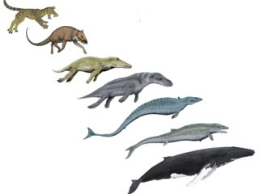
Concept Development
CFU 1
List four different forms of evidence for evolution
Evidence for Evolution
Theories explain the natural world based on a collection of well substantiated evidence
Evidence builds the validity of a theory
The Theory of Evolution was developed based on the following collection of evidence;
Fossil record
Embryology
Comparative anatomy
DNA and protein similarities
CFU 2
What effect does increasing evidence have on a theory?

Slide 9
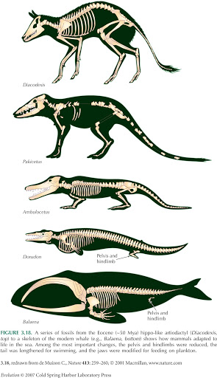
Concept Development
CFU 1
What is a fossil?
Fossil Record
Fossils are the remains or traces of organisms from a past geological age
Fossils allowed scientists to develop an understanding of extinct species
Through the use of carbon dating the age of fossils can be determined
As more and more fossils have been discovered, missing links in the evolutionary chain have been filled in order to support the Theory of Evolution
CFU 2
How do fossils help to support the Theory of Evolution?

Slide 10
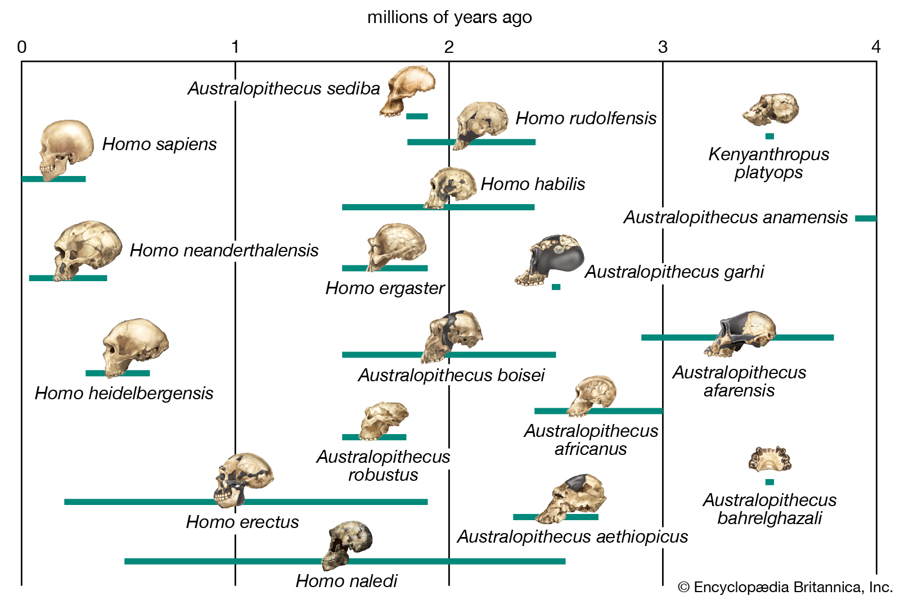
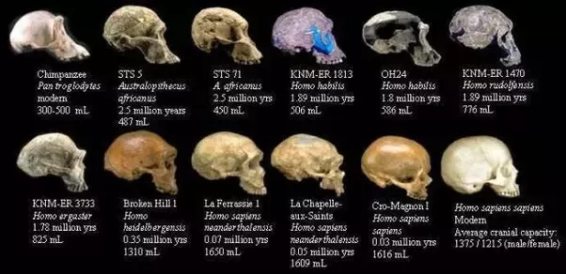
Concept Development
Human Fossil Record

Slide 11
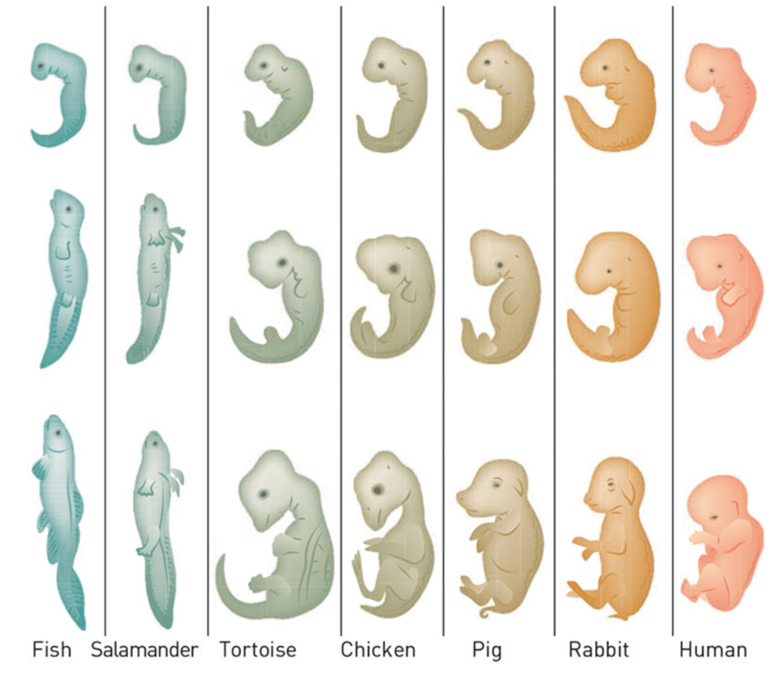
Concept Development
CFU 1
What is embryology?
Embryology
The study of how an embryo develops
Although vertebrates appear obviously different as they age, during the early stages of development they share close similarities
These similarities are explained by inferring
that these organisms all had a common ancestry
Human embryos even develop gill and
tail like structures in their early development
CFU 2
How does embryology support the Theory of Evolution?

Slide 12
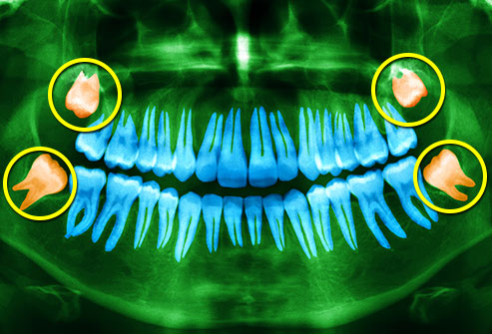
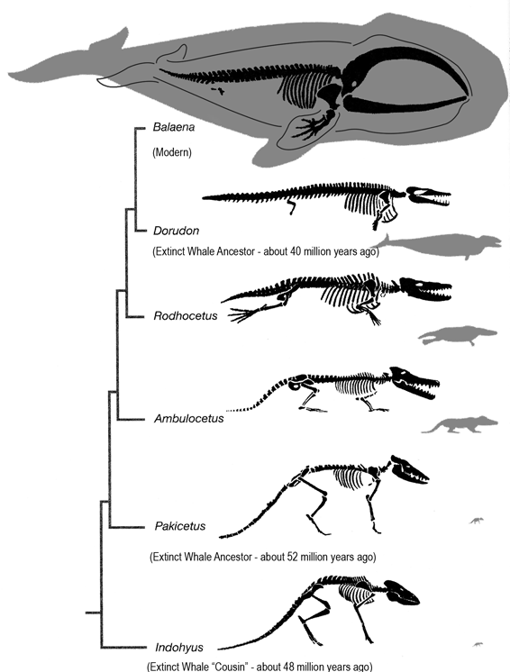
Concept Development
CFU 1
Describe two ways that comparative anatomy supports the Theory of Evolution
Comparative Anatomy
Homologous structures
Similar structures in different organisms
Evidence that the organisms diverged from a common ancestor
Vestigial structures
Functionless structures found in organisms
Provide evidence of evolution as these structures were once useful to the organism
90% of humans have wisdom teeth which never come through the gum – evidence of herbivorous ancestry
Whales still have the remnants of hind legs which is evidence that their ancestors walked on land

Slide 13
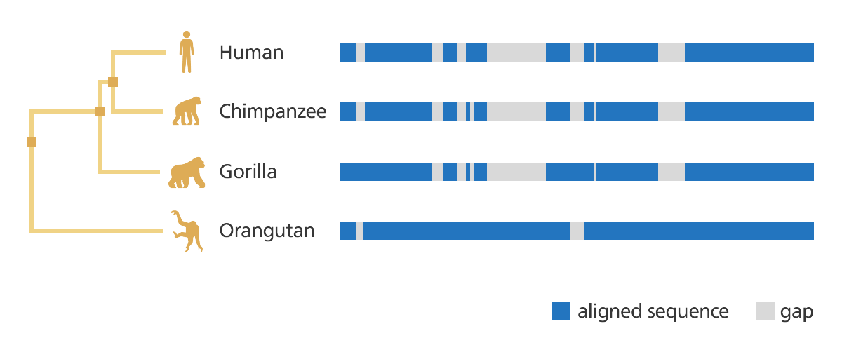
Concept Development
CFU 1
The more different the protein/DNA structure the more/less closely related the species are?
DNA and Protein Similarities
Mutations cause gradual change to DNA and protein structure over time
The more similar the DNA and protein structures the more closely related the species are
CFU 2
Looking at the DNA below, which animal is the closest to humans in the evolutionary process?

Slide 14
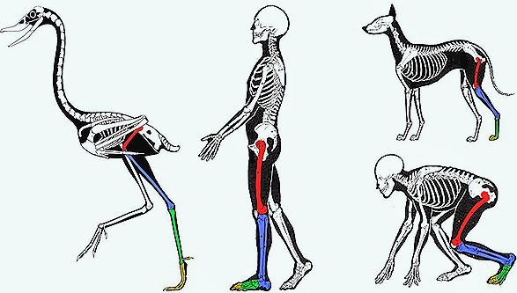
Guided Practice
What form of evidence for evolution is shown below? How does it support the Theory of Evolution?
Identifying evidence for evolution
Fossil record Embryology Comparative anatomy DNA and protein similarities
This evidence is comparative anatomy (homologous structures).
This supports the theory of evolution by showing similarities in the hind limb structure of these animals. This suggests that all of these animals evolved from a common ancestor.

Slide 15
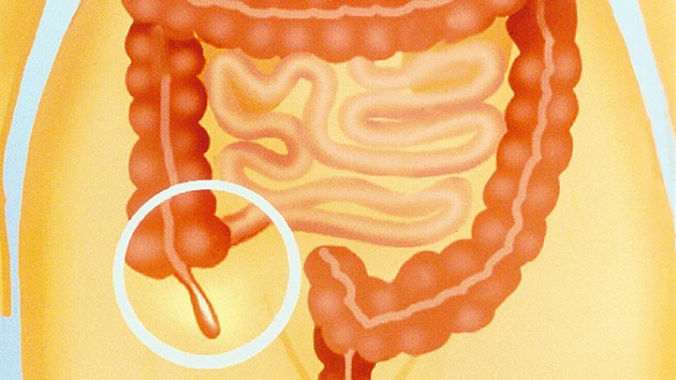
Guided Practice
What form of evidence for evolution is described below? How does it support the Theory of Evolution?
Identifying evidence for evolution
Fossil record Embryology Comparative anatomy (homologous structures/vestigial organs) DNA and protein similarities
The appendix is a part of the human digestive system that has no function in the human body.
This evidence is comparative anatomy (vestigial organs).
This supports the theory of evolution as this organ is thought to once have a use, however now has no function in the human body.

Slide 16
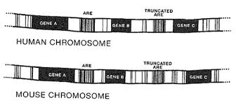
Guided Practice
What form of evidence for evolution is shown below? How does it support the Theory of Evolution?
Identifying evidence for evolution
Fossil record Embryology Comparative anatomy (homologous structures/vestigial organs) DNA and protein similarities
This evidence is DNA similarities.
This supports the theory of evolution as the similarities in the DNA sequence suggests that the house and human evolved from a common ancestor.

Slide 17
Relevance
The Theory of Evolution suggests how all of the species in the history of the Earth developed.
All theories need to be based on strong evidence in order to be valid.
These forms of evidence that you have covered today all provide this strong evidence to support the Theory of Evolution.
This helps us to understand the origins of all species on Earth, including Humans.

Slide 18
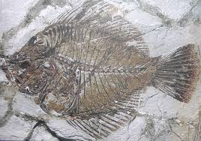
Skill Closure
Define the Theory of Evolution.
Skill Closure
Differentiate between convergent and divergent evolution.
Hint: What is convergent evolution? What is divergent evolution?
Skill Closure
How does a fossil support the Theory of Evolution?

Slide 19
Independent Practice
Complete the Evidence for Evolution worksheet.
Marigold
Rafflesia
Trumpet Vine
Cactus
Jasmine
Bottlebrush

